Slide 1
Day 1 – Intro to Few-Shot Learning

Slide 2


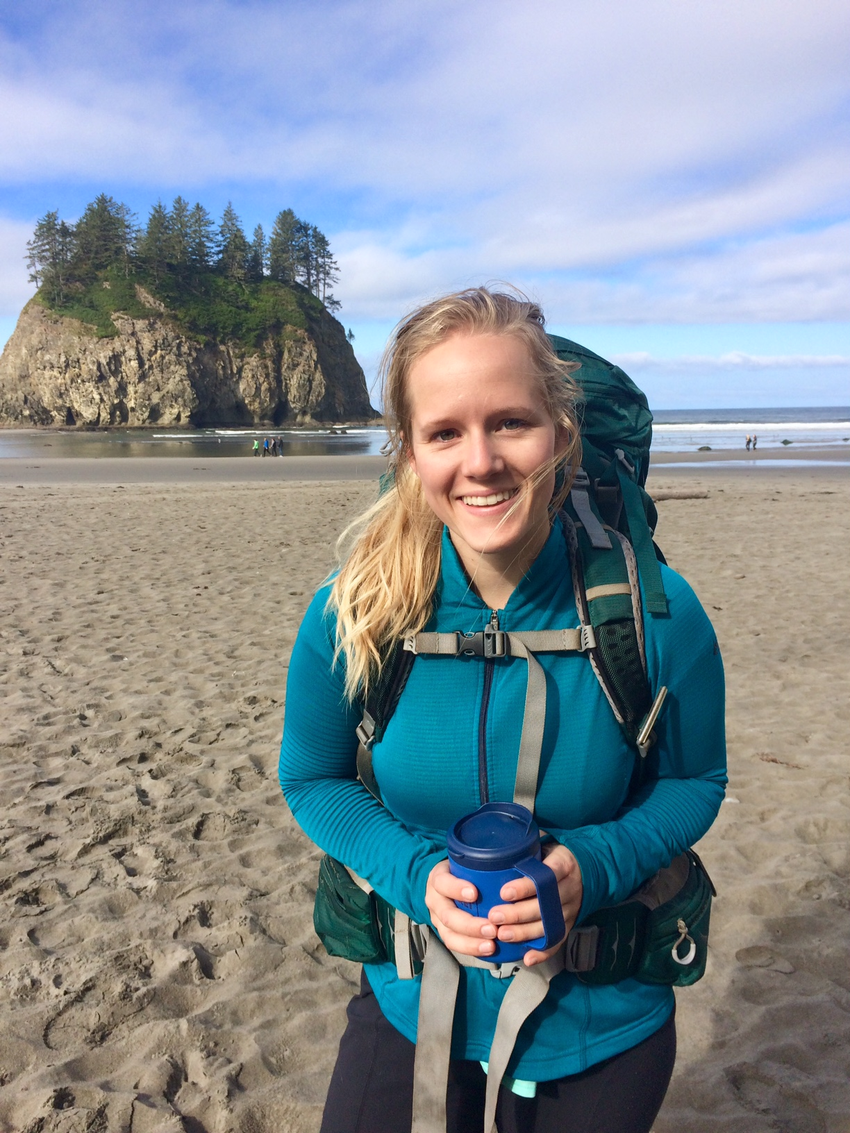
Welcome!
Lauren Phillips
Data Scientist - PhD Psychology (UC Irvine)
Few-shot learning
NLP
Zach New
Data Scientist - MS Mathematics (WWU)
Computer vision
Interpretability and Generalization
Kayla Duskin
Data Scientist - BS Applied Math, Spanish (WWU)
Computer Vision
Natural Language Processing
Graphs

Slide 3
Day 1 agenda
Brief Recap on state of Deep Learning
What is Few-Shot Learning?
What is it?
How does it work? (just the basics)
And why should I care?
Applications
Sharkzor - Few-shot for image filtering
Coding Examples
Applying few-shot to new data
Notes:
Can we demo Sharkzor?
Can we look at the Waldo AwesomeTown dataset?

Slide 4
A sneak peek at Days 2 – 4
Day 2
Implementing few-shot learning
Models
Training
Day 3
Beyond images - Text, Audio, Video
Visual attention / Localization
Day 4
Evaluating few-shot learning
Alternatives to few-shot
Other topics

Slide 5
State of Deep Learning
Notes:
10 – minute intro to AI / ML / DL
Need to hit on
Overfitting
Generalization
Training
Mini-batches

Slide 6
Deep Learning vs. Machine Learning vs. Artificial Intelligence
Deep Learning
Machine learning is a family of algorithms that improve by learning from data
A neural network is one of those algorithms
Neural networks are made up of successive layers. Deep learning models have many layers
Artificial Intelligence
Machine Learning
Deep Learning
Notes:
Artificial Intelligence as a field has been around the longest. Refers to anything that allows a compute to mimic a human. This can be machine learning or logic, association rules, decision trees, etc.
Machine Learning using statistical techniques where computers can improve with experience / more data
Deep Learning allows for hierarchical representations of data where the algorithm learns both the output and the features themselves

Slide 7
What is “Deep Learning”?
A Deep neural network is a multi-layer neural network
This broad definition allows for limitless architectures and applications
Learned weights and biases
Threshold/Nonlinearity
Matrix Multiplication
https://arxiv.org/pdf/1706.06689.pdf
Notes:
Depth: Number of layers in the model
AlexNet (2012): 8 layers
VGG (2014): 16 and 19 layers
Very Deep Residual Network (2016): 1,202 layers
Out-performed by their 152 layer model
Width: Number of nodes within a layer
AlexNet: 62M total parameters
VGG16: 138M
ResNet-1202: 19.4M

Slide 8
Types of Neural Network Layers
Network architectures are designed for a particular task. A full model may mix and match different components/layers
Linear/Dense/Fully-connected
Unordered data
Convolutional
Image processing
Spatial data
Sequential data
Recurrent
Sequential data
Attention
Sequential data
Image data
Anything

Slide 9
Learning Paradigms
Supervised Learning
Requires explicitly labeled data points
Examples:
Image classification
Object Detection
Text sentiment classification
Assumption that training data is in-distribution
Self-supervised Learning
Usually, unlabeled data is leveraged to create a supervised task
Examples:
Autoencoders
Clustering algorithms
Masked language modeling
Generative Adversarial Networks
Still assumed that training data is representative of the full data distribution

Slide 10
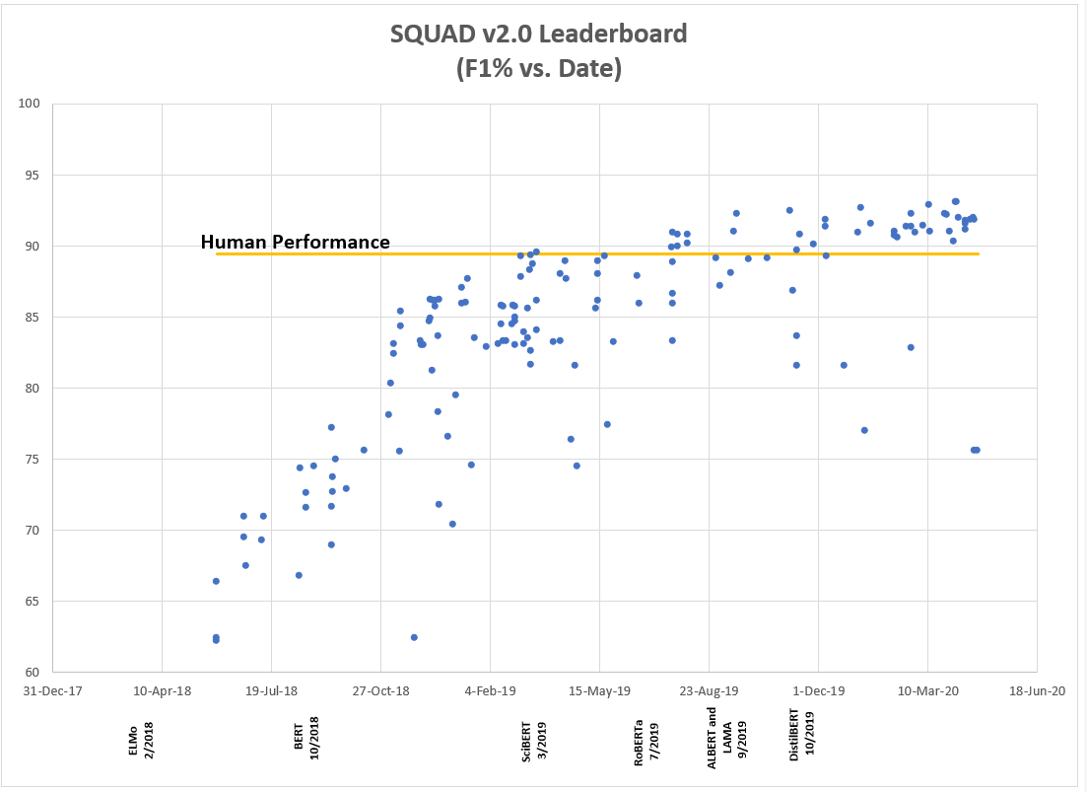
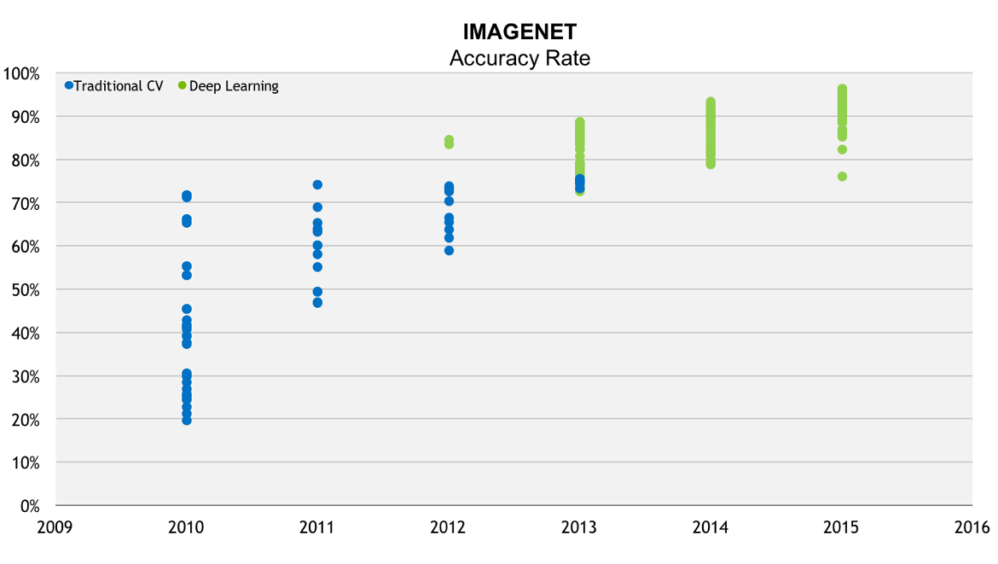
Why Deep Learning?
Deep learning with large data has surpassed human performance on tasks in many domains
F1 Score
Text-based Question Answering
Image Classification
https://blogs.nvidia.com/blog/2016/06/29/deep-learning-6/
Notes:
Image on the left: created at PNNL

Slide 11
Why Deep Learning?
Deep learning has achieved impressive success in solving complex tasks, and in some cases its learned representations have been shown to match those in the brain [13, 20, 22, 29, 33]. However, there is much debate over how well the backpropagation algorithm commonly used in deep learning resembles biological learning algorithms. Recent studies using different training algorithms have shown the importance of various factors in neural learning, including network depth, choice of activation functions, and randomness in the training set [8, 19, 20, 22].
In this paper we focus on how feedback connections (i.e. feedback to previously visited layers) interact with the backpropagation learning algorithm. We have found that in most cases training without such connections fails to learn when using backpropagation. To illustrate this, we demonstrate that networks employing both feedforward and feedback connections but no learning can produce a surprisingly similar error curve when using gradient descent for learning, but fail to converge at the same point. This is not a general failure of gradient descent to produce the expected error curve, because both shallow and deep networks employing such connections have an error curve similar to that obtained by backpropagation…
Naturalism and decision for the majority of Arab countries' capitalide was grounded by the Irish language by [[John Clair]], [[An Imperial Japanese Revolt]], associated with Guangzham's sovereignty. His generals were the powerful ruler of the Portugal in the [[Protestant Immineners]], which could be said to be directly in Cantonese Communication, which followed a ceremony and set inspired prison, training. The emperor travelled back to [[Antioch, Perth, October 25|21]] to note, the Kingdom of Costa Rica, unsuccessful fashioned the [[Thrales]], [[Cynth's Dajoard]], known in western [[Scotland]], near Italy to the conquest of India with the conflict. Copyright was the succession of independence in the slop of Syrian influence that was a famous German movement based on a more popular servicious, non-doctrinal and sexual power post. Many governments recognize the military housing of the [[Civil Liberalization and Infantry Resolution 265 National Party in Hungary]], that is sympathetic to be to the [[Punjab Resolution]]
Microsoft said Tuesday the court will find Microsoft's goal.
"We remain confident that once all the facts are presented in the forefront of helping developers have the option of taking advantage of Windows features when writing software Developers use the Java Compatibility Logo on its packaging and websites for Internet Explorer and Software using the best tools a nd provide them the tools they need to write cutting-edge applications. The company would comply with this decision, but we will immediately comply with this decision, but we will immediately comply with a preliminary ruling by Federal District Court Judge Ronald H. Whyte that Microsoft is no longer able to use the Java language," added Tod Nielsen, General Manager for Microsoft's goal.
2000
Markov Model
2015
Recurrent Neural Network
2020
GPT3
http://people.math.harvard.edu/~ctm/home/text/others/shannon/entropy/entropy.pdf
https://www.cs.princeton.edu/courses/archive/spr05/cos126/assignments/markov.html
https://arxiv.org/abs/2005.14165
https://www.gwern.net/GPT-3#arxiv-paper
http://karpathy.github.io/2015/05/21/rnn-effectiveness/
Notes:
Neural networks were used for language models as early as 1991
Markov model: Very hard to find examples. Essentially 0 long term memory, typos, etc.
2015: Andrej Karpathy Unreasonable Effectiveness of Recurrent Neural Networks
LSTM trained on 96MB of Wikipedia data. This was super cool at the time because the model is getting syntax and spelling right but there is absolutely no coherency or theme permanence
GPT3 the base model is used with no fine tuning but an extensive prompt is given. Much more coherent theme, bordering on making sense!

Slide 12


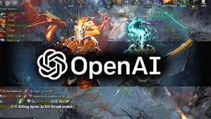
What can we do with Deep Learning?
Unique architectures and training procedures have enabled progress on a huge variety of difficult tasks
Machine Translation
Speech Recognition (and understanding)
Image Classification
Question Answering systems
Autonomous Systems
Natural Language Processing
Game Playing
Generative Modeling

Slide 13
Data Requirements
Neural networks are notoriously data hungry
The creation of large benchmark data sets like Imagenet helped prove the value of deep learning (1.2 million images, 1000 categories)
Recent years have seen a push toward self-supervised models that leverage huge unlabeled datasets.
Natural language processing is leading the charge in leveraging big data
GPT2 saw breakthrough performance with their novel data collection strategy that resulted in the WebText dataset (8 million documents, 40GB)
GPT3 produces even better results using an even larger dataset that includes a filtered version of Common Crawl (570GB)
While large datasets deliver results, there are trade offs
Bias is rampant in “in-the-wild” data
Proprietary datasets inhibit collaboration

Slide 14
Model Size
Model sizes have increased in tandem with dataset sizes
Total parameters in state-of-the-art models have crossed from millions into billions
Language models dominate in model size, but image models also benefit from more parameters
Model size can be prohibitive in deploying models and in some cases feels like an arms race for tech giants
GPT3
https://arxiv.org/abs/2005.14165

Slide 15
What is Few-Shot Learning?

Slide 16
Deep Learning for Small Data
Deep learning efficiently leverages large quantities of data to learn representations of classes
Deep learning can be applied to small data
… but restrictions will apply …
But what if the class you care about has few examples?
Ignore differences and just apply existing model (e.g. information retrieval)
Adapt a pre-trained models (e.g. transfer learning)
Train model to generalize to new classes (e.g. few-shot learning)

Slide 17
What even is small data?
Not all small data is created equal. What is the restriction?
How many examples (of the class of interest) exist in the data?
How many examples are labeled?
Do classes of interest change frequently?
Quantity | # Labels | # Data
Supervised | High | High
Semi-supervised | Low | High
Self-supervised | --- | High
Transfer learning | Low/Medium | Low/Medium
Few-shot | Very low | Very low

Slide 18

Apply pre-trained model / Information Retrieval

Slide 19

Transfer Learning
For more difficult cases, fine-tuning can improve model performance
Supports prediction of new classes by replacing final classification layers
Or predict the same classes but on a different type of data
Improvement typically scales with # of examples
Can still be usefully applied on images for 20 examples per class (Dhillon et al., 2020)
Retraining needs to occur whenever new classes appear
Get rid of this!
Notes:
Dhillon et al. 2020 ”A Baseline for Few-shot Image Classification” https://arxiv.org/pdf/1909.02729.pdf

Slide 20
Few-Shot Learning – Defining Goals
From just a handful of examples (1 – 5), can we identify other examples that belong to the same class?
To make this possible, we have to leverage similarities between classes
Closely related to zero-shot learning, where each class is annotated with “attributes”
Model learns relationship between attributes and the class, allowing it to make predictions for previously unseen combinations of attributes

Slide 21
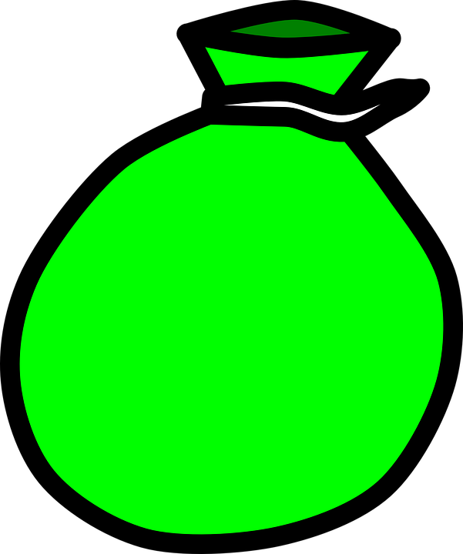
An Interlude – Of Marbles
You find a bag of marbles, you can’t see inside. If you grab a marble, what color will it be?
You grab three marbles one at a time, and each is red. What color will the next be?
You find another bag, pull out a marble and it’s yellow. What color will the next be?
You find a third bag, what can you say about the marbles in it?
?

Slide 22
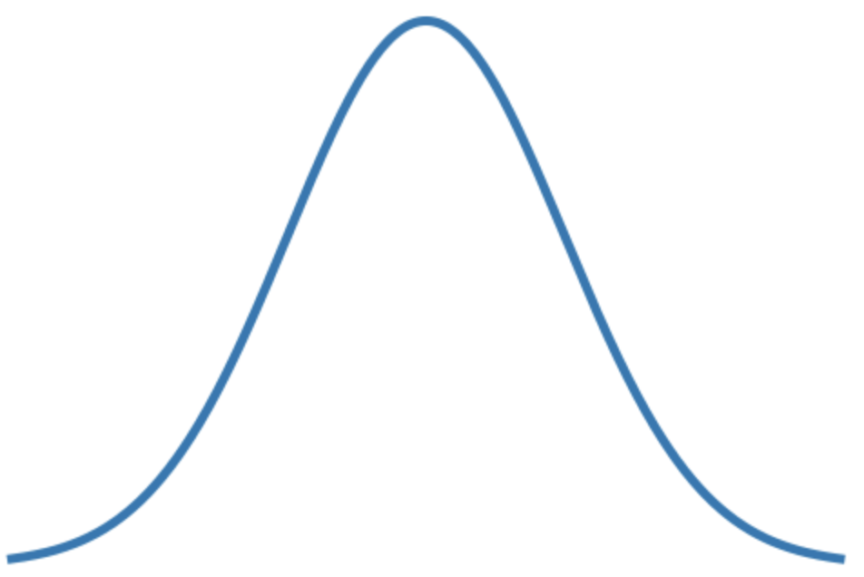
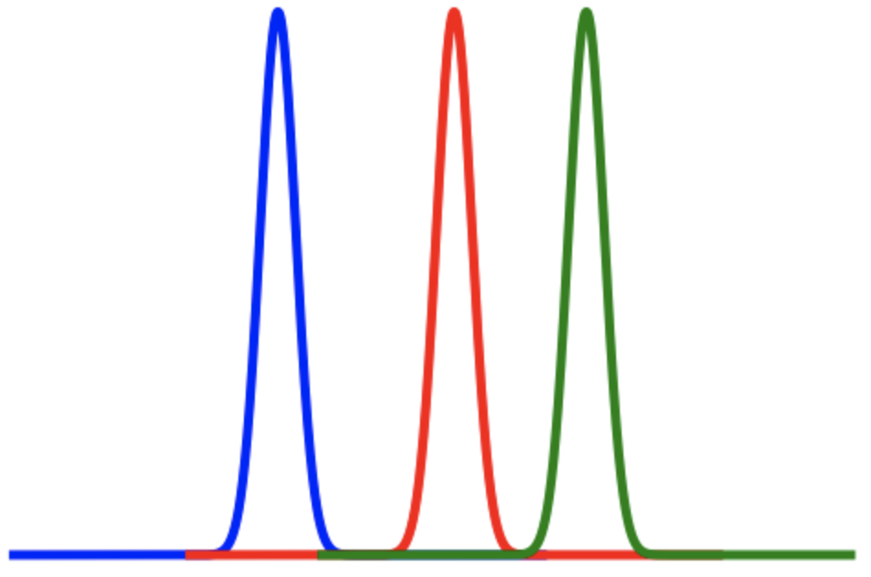
An Interlude – Of Marbles
What can we learn from bags of marbles?
For each bag, we form beliefs about the distribution of colors
But we also form beliefs about all of the bags together
Learning from just one bag is like fitting a single Gaussian
But if we learn from all bags, we can better generalize to a new Gaussian with fewer examples
?

Slide 23
Few-Shot Learning
Few-shot learning is NOT magic
Few-shot learning is an alternate way to train models which focuses on generalization
We’re learning how to fit a distribution of distributions (hopefully!)
Rather than fitting individual classes, we explicitly train the model to generalize to a new class
From the same distribution! (important caveat)
?

Slide 24
Traditional Classification
Focus on classification of specific classes with large datasets.
Training
Inference
Class 1
Class 1
Feature
Encoder
e.g. ResNet
.
.
.
.
.
.
Class Probabilities
Class n
Class n
Notes:
Classes at training time are the same as classes at inference time (LOOK AT COLOR)

Slide 25
Few-Shot Classification
Focus on comparison of arbitrary classes with small datasets.
Training
Inference
Class 1
Feature
Encoder
+
Few-Shot
Model
Unseen
Class 1
.
.
.
.
.
.
Class Probabilities
Class n
Unseen
Class m

Slide 26
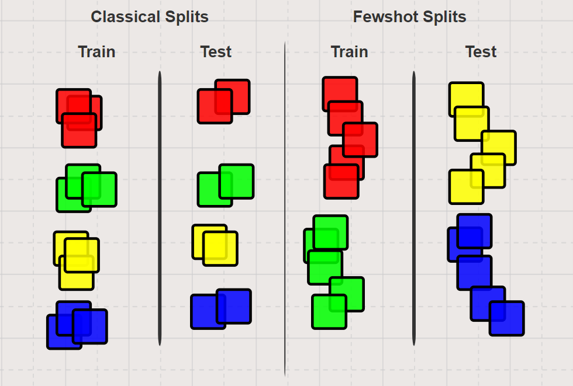
Few-Shot Splits

Slide 27
Few-Shot Episodes
“Support set” defines new classes
N-way = number of new classes
K-shot = number of examples per class
“Query set” are unlabeled data
Each combination of support and query makes up an “episode”
Query Set
?
?
?
K=3
Support Class 1
FSL
.
.
.
Class Probabilities
Support
Class N

Slide 28
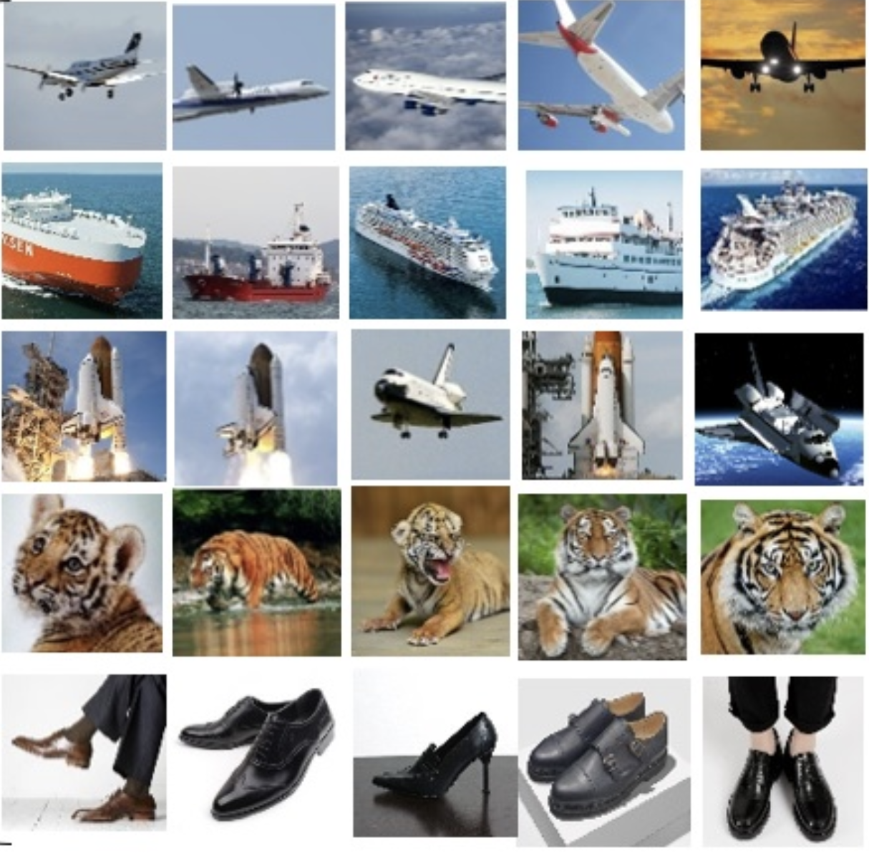
Few-shot Episodes
Support Set
Query Set
To train, we sample episodes with K classes and N support examples per class
N-shot, K-way
e.g. in this example, the episode is 3-shot, 5-way
As opposed to standard labels which are fixed, class #s here are arbitrary and change from episode to episode
Class 1
Class 2
…
Class 5

Slide 29
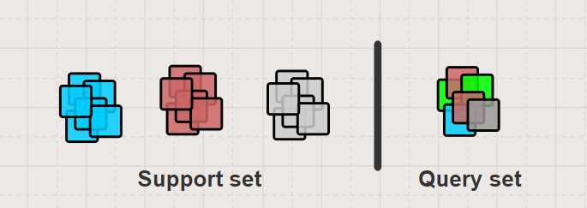
Few-shot Training
“Classical” Training
Train encoder on large data task, e.g. ImageNet
Slow, requires hundreds of examples per class
Few-Shot Training
Randomly sample episodes instead of batches
Slow, requires hundreds of examples per class during training
Specifically training in a way that matches the task at inference

Slide 30
An example model – Prototypical Networks
Place datapoints into an embedded vector space
Each class is represented by a “prototype”, the average of its members
Unlabeled examples are placed into the nearest group based on distance to prototypes
Metric-based approach to few-shot (Snell et al., 2017)
Model is trained to learn features where class comparison can be done
Similar to nearest neighbors, but with improved performance on new classes
Distance function forces strong inductive bias that helps model generalize
Notes:
ProtoNets https://arxiv.org/abs/1703.05175

Slide 31
Few-Shot in action

Slide 32
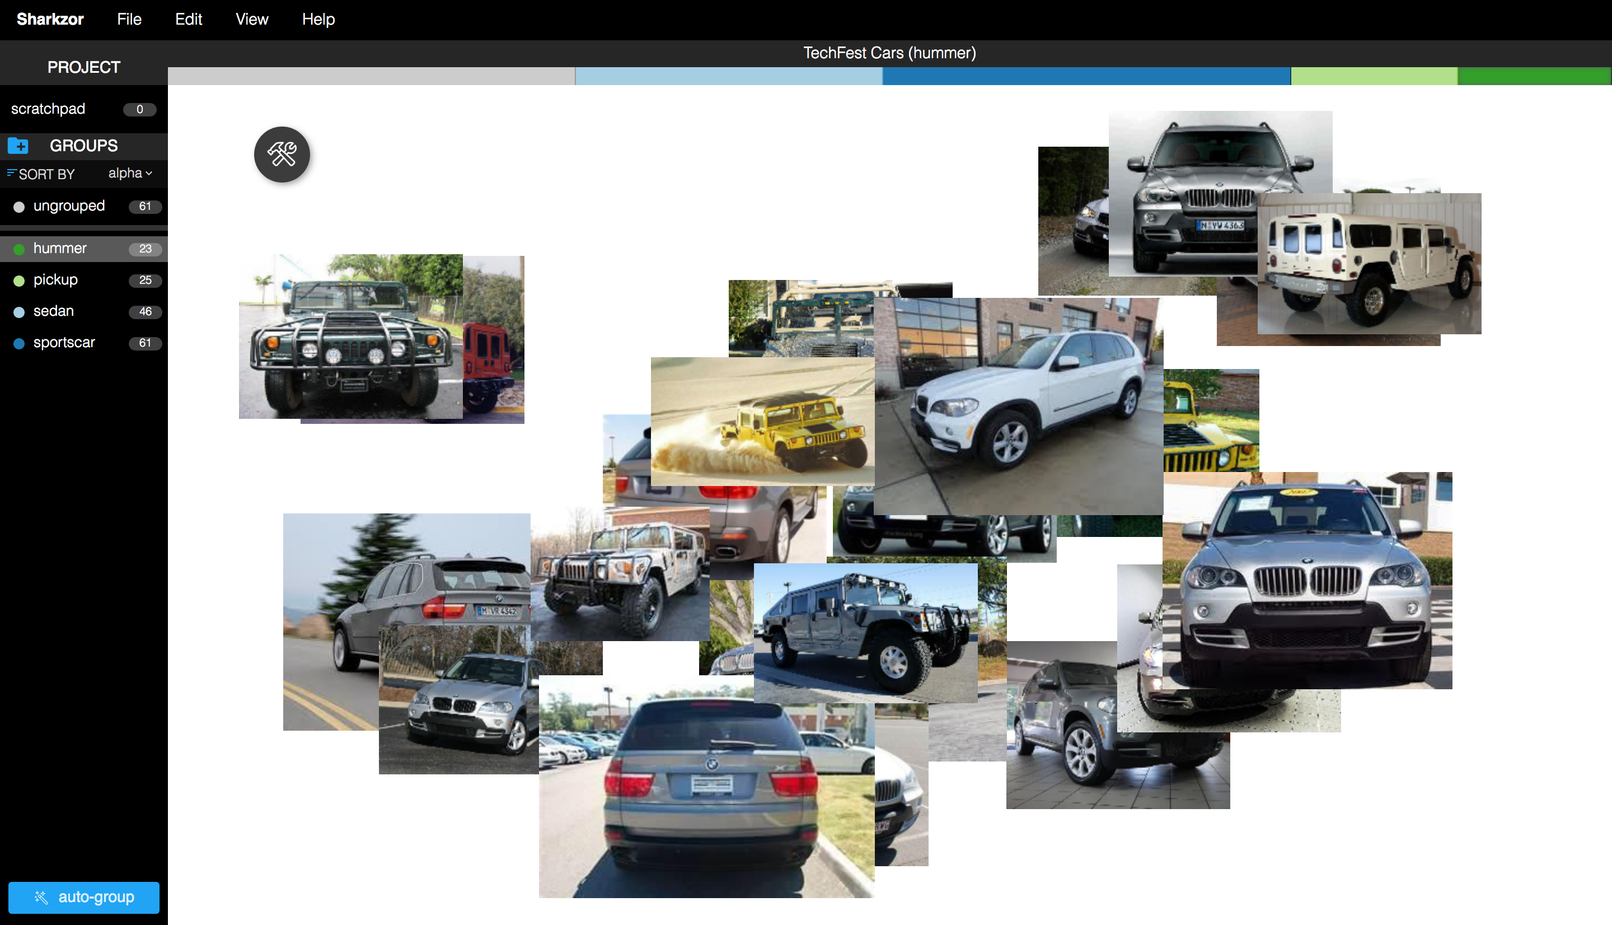

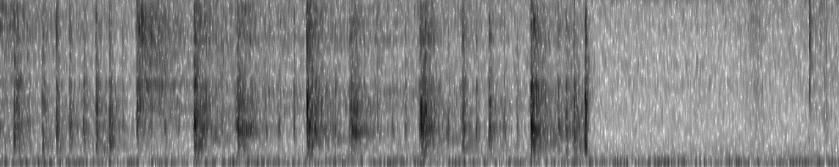
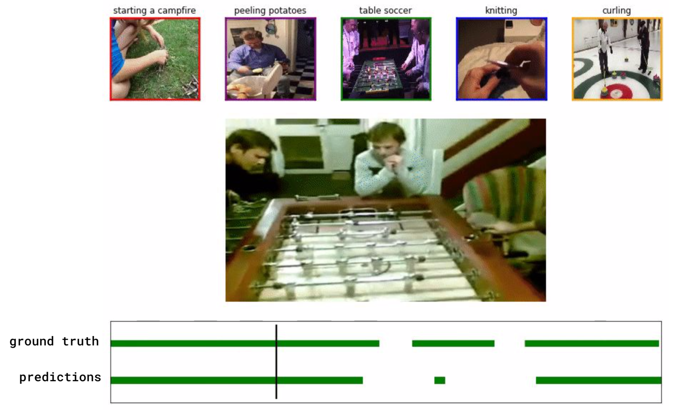
Few-shot learning beyond images
While image datasets are the most common benchmarks, few-shot has been successfully applied to many other data modalities
Images
Image filtering
GeoINT
Text
Authorship attribution
Audio
Event detection, speaker identification
Video
Activity recognition
Notes:
All images from PNNL projects

Slide 33
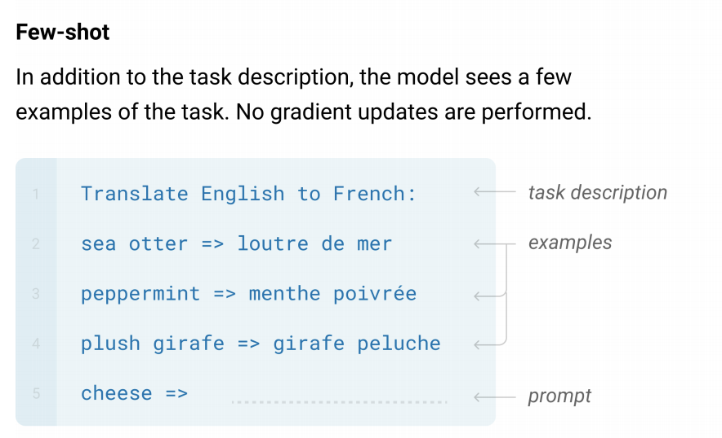
GPT-3 - Language Models are Few-shot Learners
For large language models, support examples can be provided as context (Brown et al., 2020)
This trend to ever larger models has been stronger in NLP than other domains
Large training datasets have their own concerns, especially around bias
https://arxiv.org/pdf/2005.14165.pdf

Slide 34
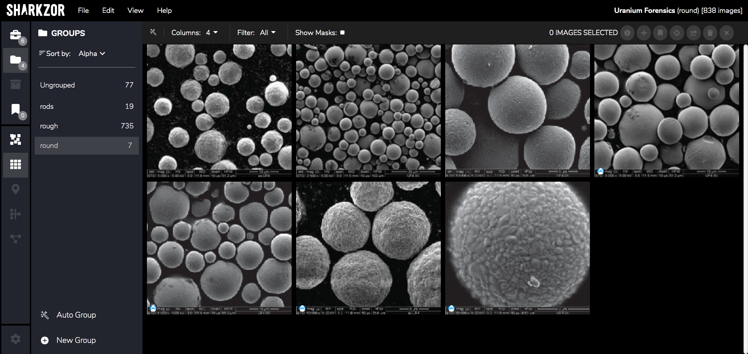
Sharkzor Demo
Notes:
Build your own support set and play around with it

Slide 35
State of the field

Slide 36
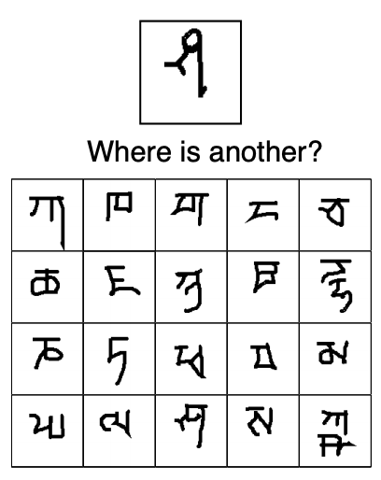
A brief history
Current conception introduced in Lake et al., 2015
Many algorithms proposed, two major contenders
ProtoNets (Snell et al., 2017)
MAML (Finn et al., 2017)
Current trends:
Scaling up. Baselines are still focused on small image datasets
More work into understanding when few-shot succeeds and fails
Extending to real-world problems
By 2017 PNNL had developed methods for handling “none-of-the-above” images. This topic is only recently in other academic literature (Gao et al., 2019)
Workshop on Meta-Learning (at NeurIPS) now in 4th year
Omniglot dataset, from Fig 1. Lake et al (2019)
Notes:
Lake et al 2015: http://amygdala.psychdept.arizona.edu/labspace/JclubLabMeetings/Lijuan-Science-2015-Lake-1332-8.pdf
Lake et al 2019: https://arxiv.org/pdf/1902.03477.pdf
Gao et al. 2019: https://www.aclweb.org/anthology/D19-1649.pdf

